Slide 1
PREDICTING OUTCOMES OF
SECURITIES CLASS ACTION PROCEEDINGS
GSU - DATA MANAGEMENT COURSE
Fall 2018
Chris Cirelli
Sarmad Ejaz

Slide 2
Content
Introduction - Securities Class Actions, D&O Insurance
Problem Statement
Data - Source
Data - Retrieval and storage
Analysis - Basic relationships & observations between target and features
Application Machine Learning Algorithms
Results
Key Takeaways & Further Analysis
Appendix

Slide 3
INTRODUCTION
A securities class action, or securities fraud class action, is a lawsuit filed by investors who bought or sold a company's securities within a specific period of time (known as a “class period”) and suffered economic injury as a result of violations of the securities laws*.
Directors & Officers insurance is a risk transfer product that indemnifies a company and its directors for the defense costs and certain financial damages that result from the filling of a securities class action lawsuit.
D&O Market
$6bn Annual revenues
Since 1996:
$97 Billion amounts paid by plaintiffs for SCA lawsuits
38,823 companies sued
Notes:
*source:

Slide 4
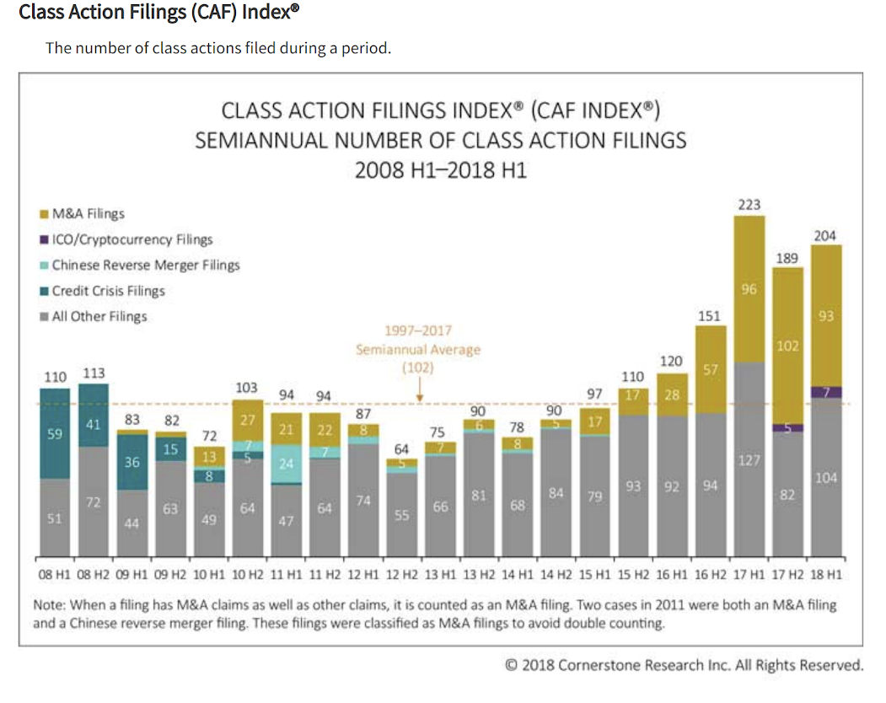
Problem Statement
Securities Class Actions lawsuits are at an all time high.
Pricing for D&O Insurance is at an all time low.
Insurance carriers are struggling to provide D&O insurance profitably.
Presently, we are not aware of a predictive model based on NLP and Machine Learning approaches to predict the outcomes of SCA lawsuits.

Slide 5
Objective Statement
“Build a predictive model for the outcomes of Securities Class Action lawsuits utilizing publicly available information, natural language processing and machine learning techniques.

Slide 6

Data Source
Domain: Securities Class Actions
Period: 1990 to present
Source: Stanford Law
Cases: + 5,000

Slide 7
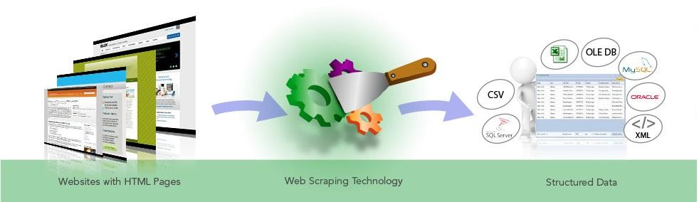

Data: Retrieval Process
STRUCTURED VALUES
Database
SCRAPER
Attributes: 68
Date Time: 7
Categorical 9
Derived 52
INSERT STATEMENTS
DERIVED VALUES
Case Level Pages
http://securities.stanford.edu/index.html

Slide 8
FINAL MACHINE LEARNING DATASET
Scraped Values
Derived Values - Appearance (1/0) In Lawsuit Description
Categorical Attributes
Sector
Industry
Headquarters (jurisdiction)
Company_market (exchange)
Court
Judge
Plaintiff_firm
Class_Duration
Financial Metrics Mentioned
Net_Income
Cash_Flow
Revenue_Rec
Documents Referenced
10K_Filling
10Q_Filling
Press_Release
Proxy
Statute/Claim Type
1934_Exchange_Act
1933_Act
Derivative
10b5
Class_action
ERISA
FCPA
SEC_Investigation
Allegations
Breach_Fiduciary_Duties
Proxy_violation
Related_parties
Stock_Drop
Customers
Corporate_Governance
Conflicts_Interest
Accounting
Fees
Failed_disclose
False_misleading
Commissions
Heavy_trading
Sexual_Misconduct, Data_breach
Quarter of Alleged Wrongful Act
First Quarter
Second_Quarter
Fourth_Quarter
Third_Quarter
Transaction
Merger
Bankruptcy Secondary_Offering, IPO

Slide 9
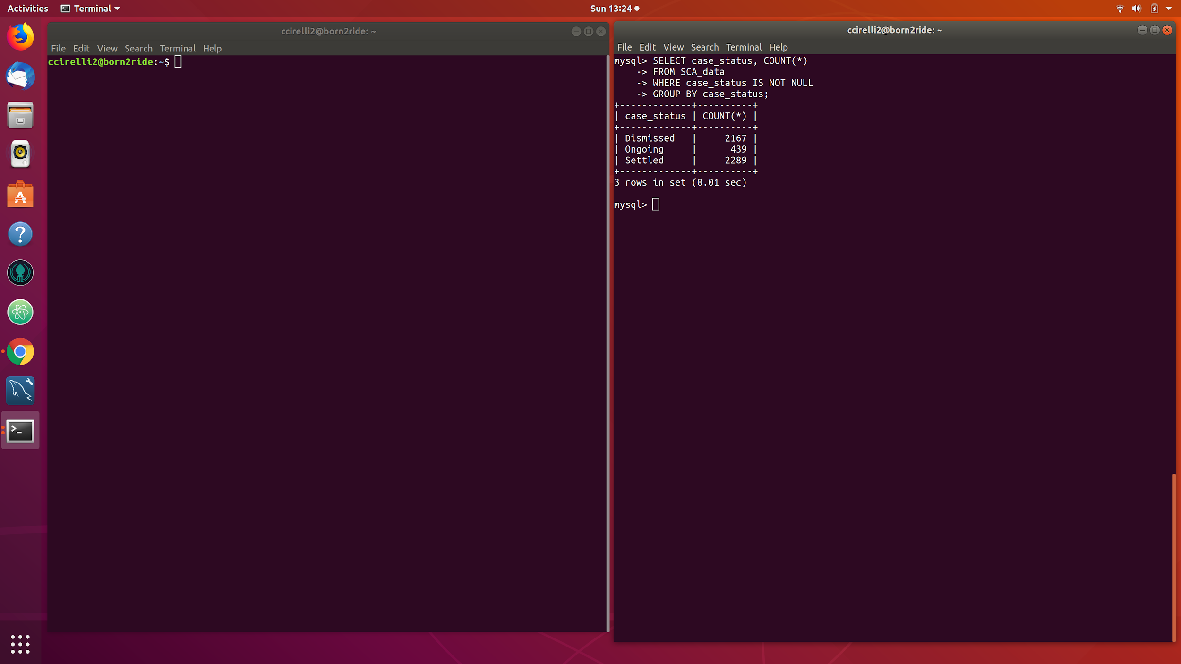
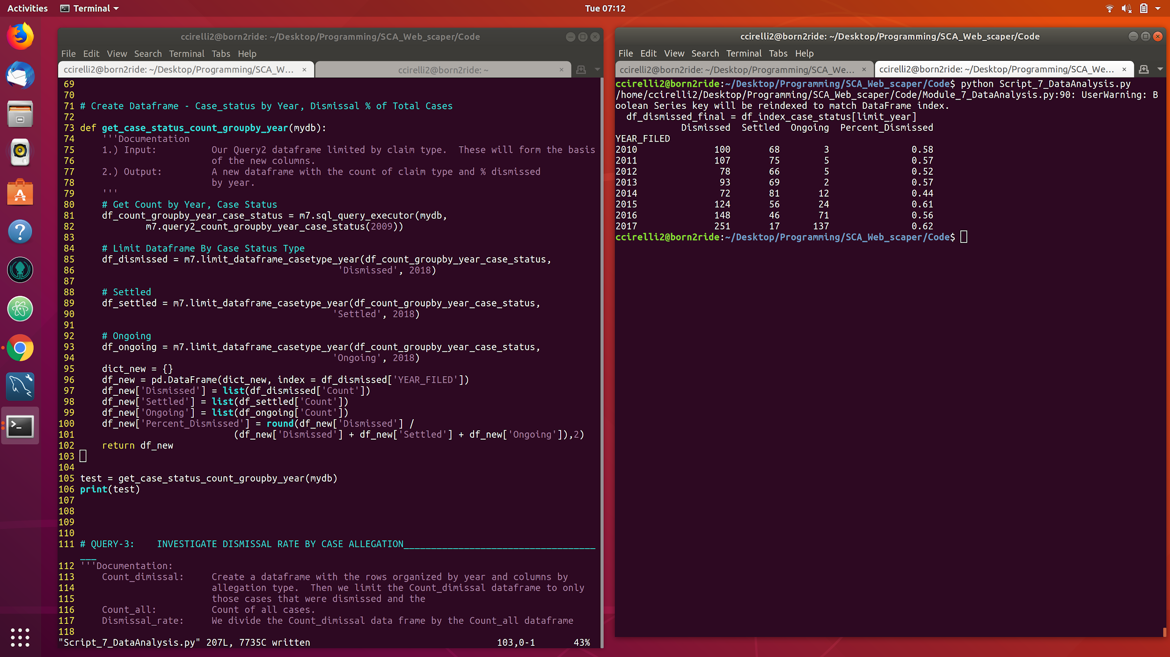
PRELIMINARY DATA ANALYSIS - DISTRIBUTION
Are there basic relationships between our independent and dependent variables that can provide insight into which factors may be most predictive of a case dismissal?
Dependent Variable:
Case Status
Independent Variables:
Plaintiff Firm
Sector
Judge
Court
Dismissal Rate (All Cases):
48% all cases
Dismissal Rate By Year:
No evenly distributed
Notes:
Pretty even split between cases settled and dismissed since 1997.

Slide 10
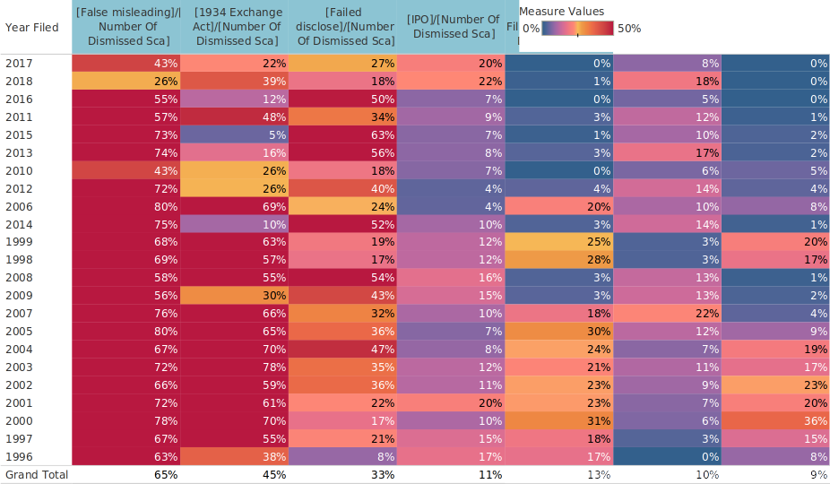
DATA ANALYSIS - DERIVED FEATURES APPEARANCE & DISMISSALS
Notes:
Pretty even split between cases settled and dismissed since 1997.

Slide 11
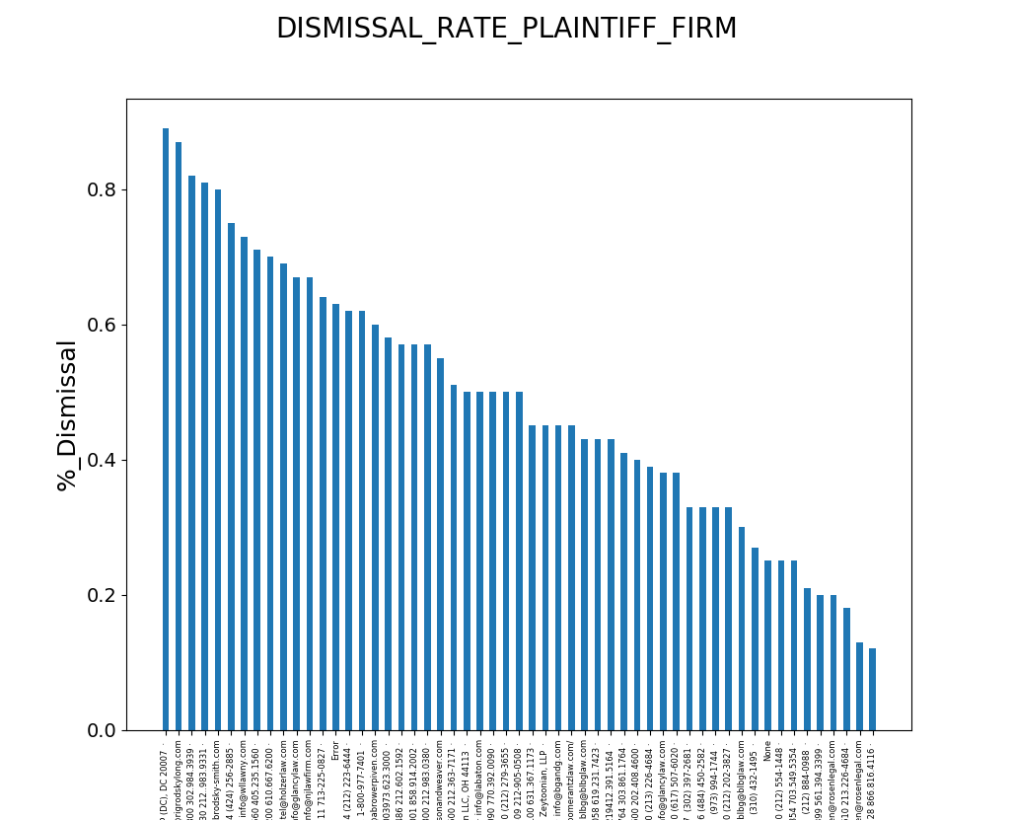
Dismissal Rate - Plaintiff Firm
Relationship:
Percentage of cases dismissed grouped by plaintiff firm.
Key Observations:
There is a 70% spread between the plaintiff firm with the highest/lowest rate of dismissal.
These results may indicate something about the quality of the plaintiff firm or the type of cases they decide to take.
Data: 2010 to present

Slide 12
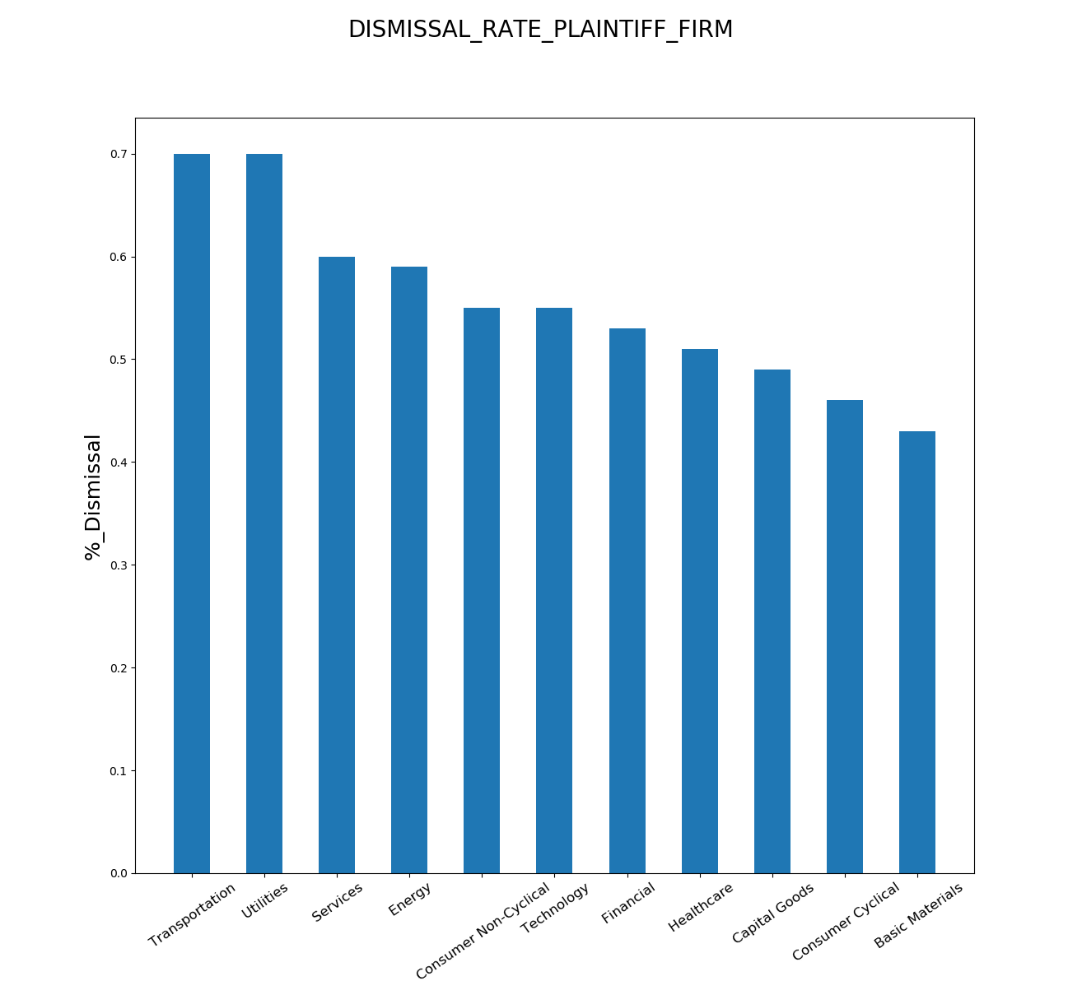
Dismissal Rate - Sector
Dismissal Rate by Sector
Relationship:
Percentage of cases dismissed grouped by Sector.
Key Observations:
There is a 25% difference between the lowest and highest dismissal rate by sector.
The dismissal rate does not follow the same sectors that receive the highest incidence of claims.

Slide 13
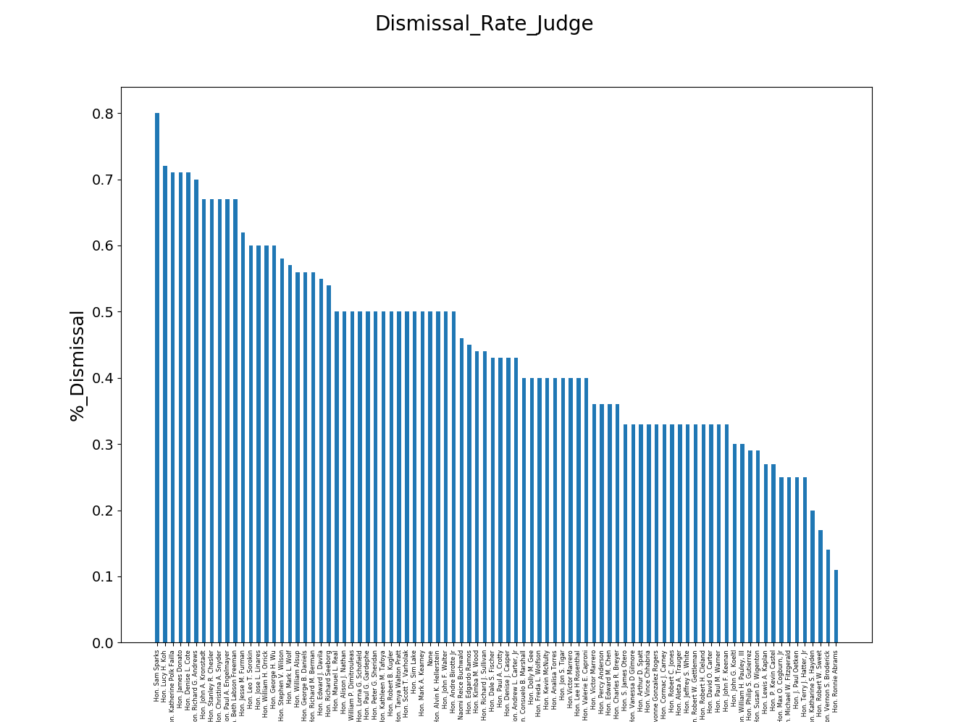
Dismissal Rate - Judge
Relationship:
Percentage of cases dismissed grouped by Judge.
Key Observations:
There is a 70% difference between the lowest and highest dismissal rate by Judge.
This could be indicative of judges that are more sympathetic to defendants or less “big business orientated” .

Slide 14
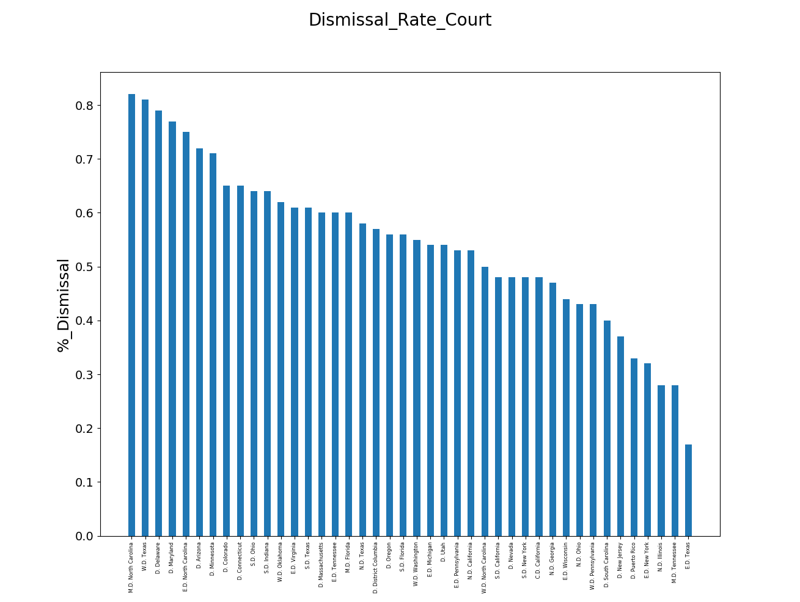
Dismissal Rate - Court
Relationship:
Percentage of cases dismissed grouped by Judge.
Key Observations:
There is a 70% spread between the lowest and highest dismissal rate by Judge.
This could be indicative of judges that are more sympathetic to defendants or less “big business orientated” .

Slide 15
Preliminary Observation
Based on the preliminary analysis of a handful of categorical attributes associated with SCA case outcomes suggests that we may be able to develop an effective predictive model for outcomes of future securities class action cases based on these attributes.

Slide 16
MACHINE LEARNING - APPROACH
Algorithms:
Nearest Neighbor (KNN)
Naive Bayes
Logistic Regression
Random Forest
Model Performance Comparison
Feature Importance
Key Takeaways

Slide 17
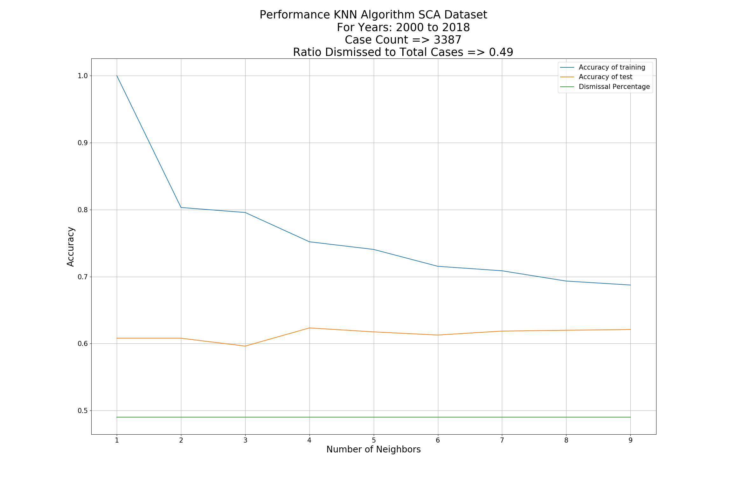
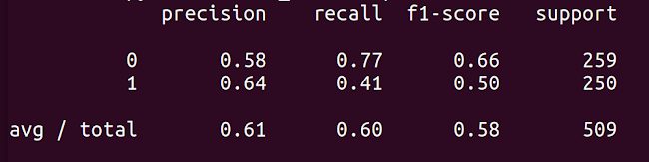
KNN Algorithm
Test:
Utilized the Nearest Neighbor Algorithm to predict the outcome of the SCA lawsuits.
Years: 2000- 2018
3387 cases
49% Dismissal percentage (close to even)
Results:
Model appears to perform best with 4-5 neighbors.
Precision: When we predicted dismissal 64% of the time we were correct.
Recall: When the outcome was actually a dismissal, we were right 47% of the time.
Poor results
Model Performance
score(X, y[, sample_weight]) Returns the mean accuracy on the given test data and labels.
Notes:
Precision = TP / (TP+FP); Accuracy in predicting our target.
Accuracy = (TP + TN) / (TP+TN+FP+FN); How often our model predict both the TP and TN.

Slide 18
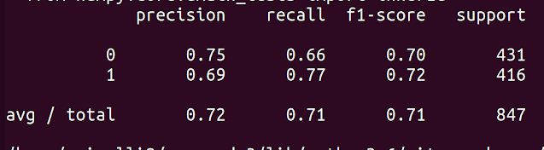
Logistic Regression
Test:
Utilized the Logistic Regression Algorithm to predict the outcome of the SCA lawsuits.
Years: 2000- 2018
3387 cases
49% Dismissal percentage (close to even)
Results:
Logistic regression materially outperforms the KNN model.
Precision: When we predicted dismissal 69% of the time we were correct.
Recall: Jumped to 77%.
Improved results
Classification Report Output:
score(X, y[, sample_weight]) Returns the mean accuracy on the given test data and labels.
Notes:
Precision = TP / (TP+FP); Accuracy in predicting our target.
Accuracy = (TP + TN) / (TP+TN+FP+FN); How often our model predict both the TP and TN.
Recall = TP / (TP + FN) = Predicted yes / total actual yes

Slide 19
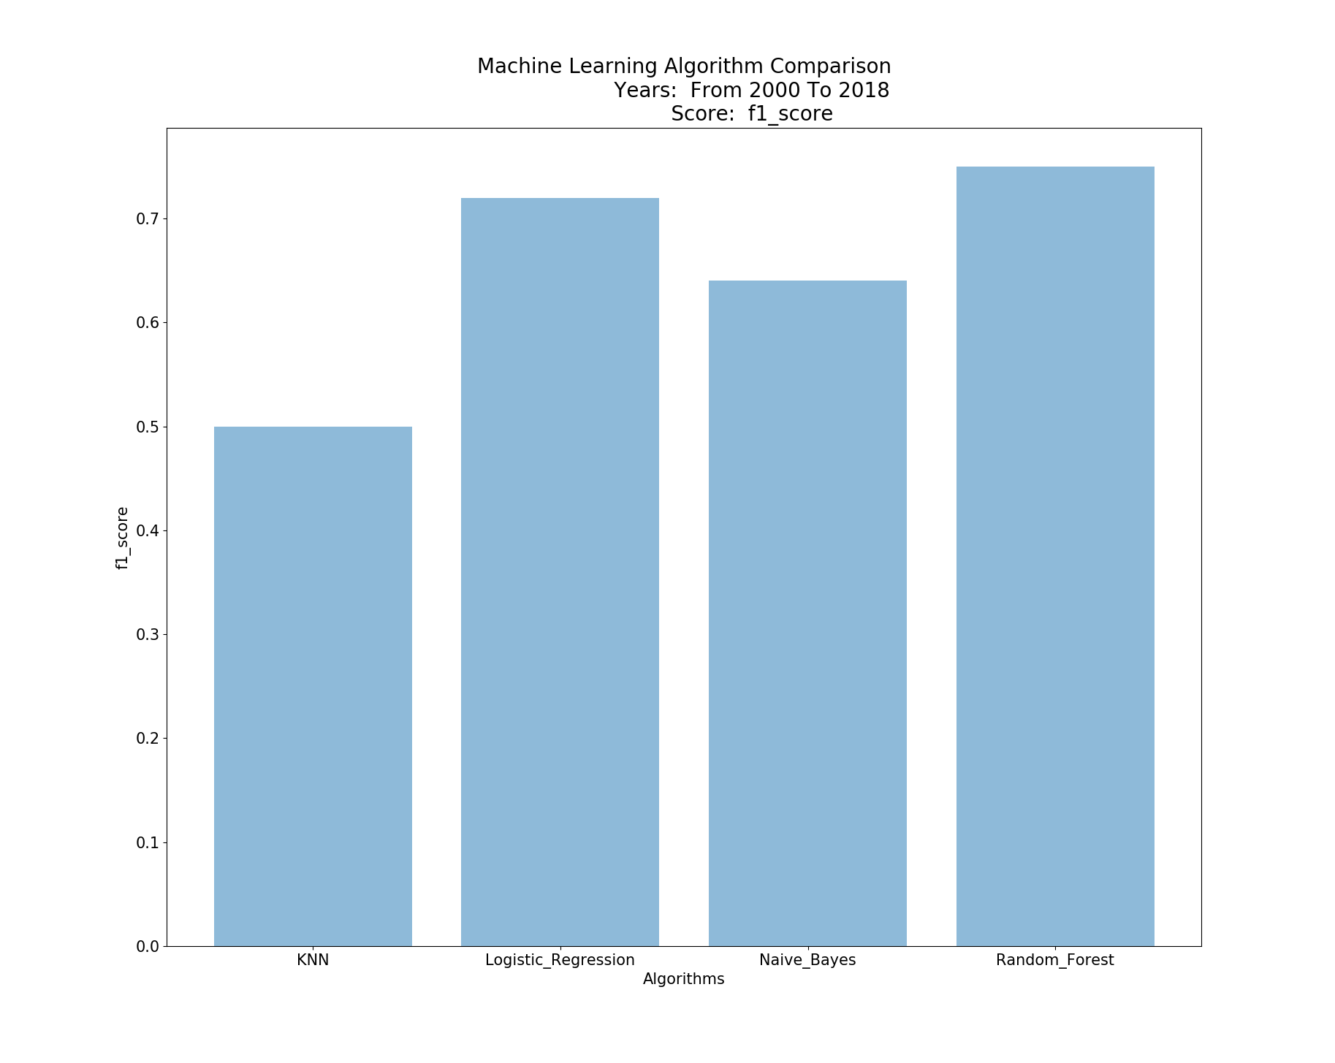
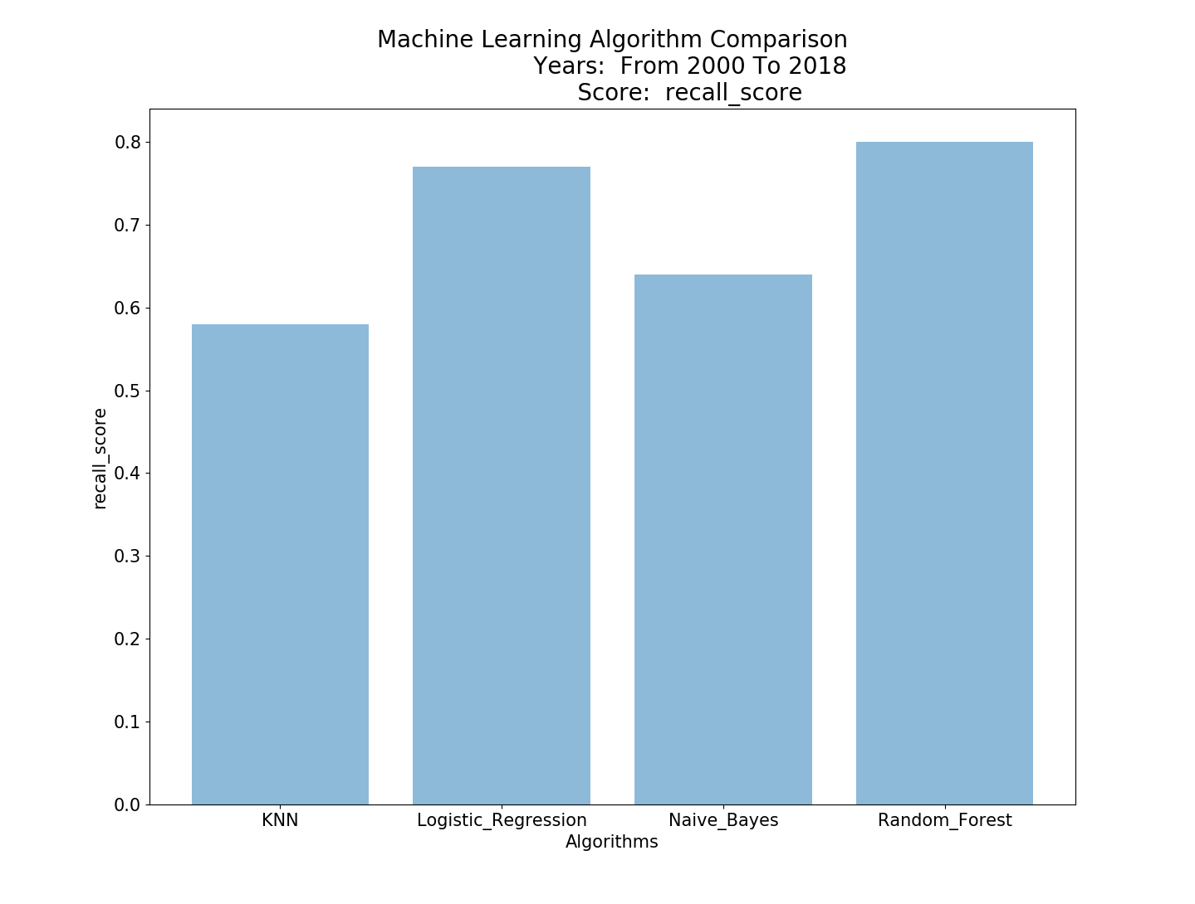
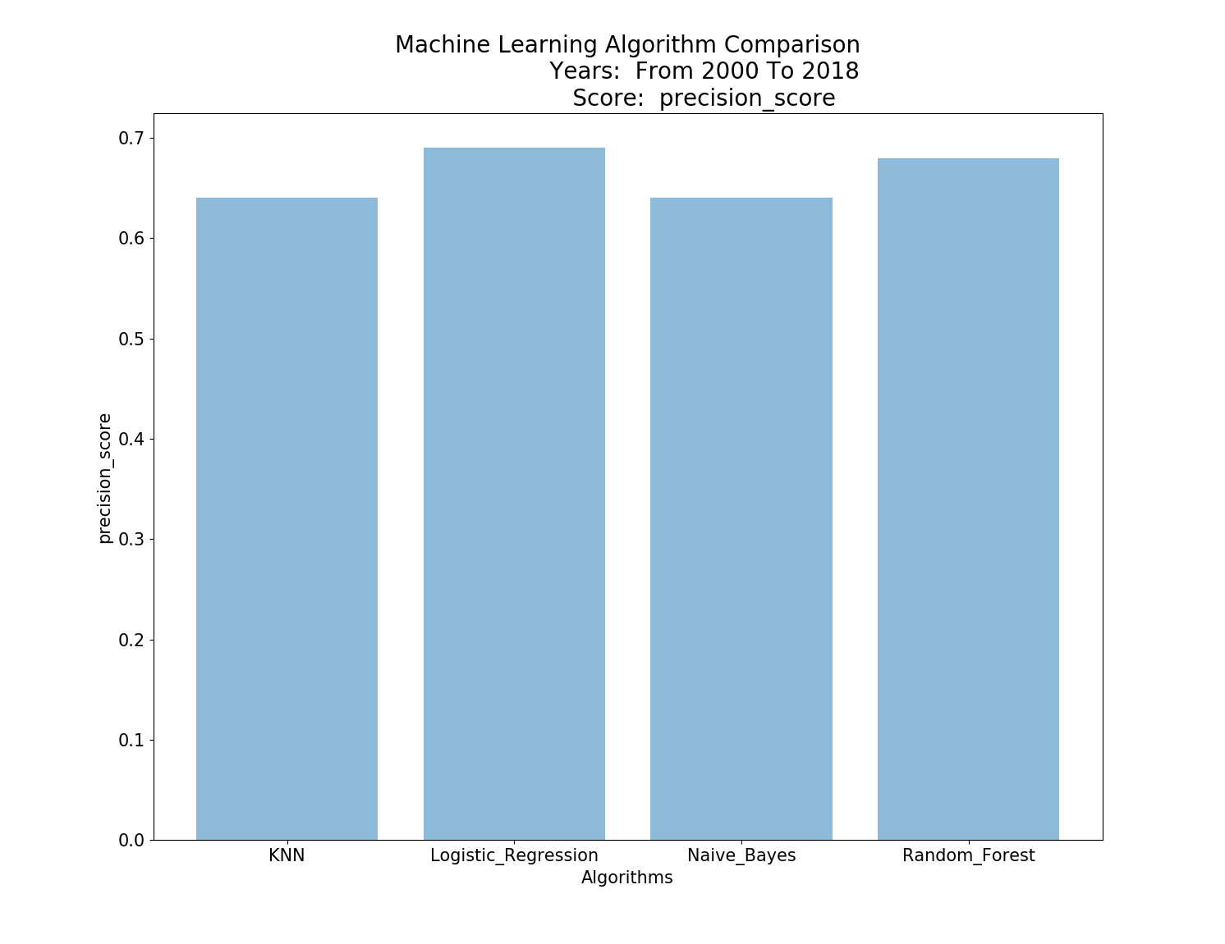
ML Pipeline
Algorithms:
KNN, Logistic Regression, Naive Bayes, Random Forest
Key Performance Indicators:
Precision, Recall, F1_score
Results:
Random Forest & Logistic regression performed best for all KPI’s.
Superiority of the Random Forest model is due to its ability to not be affected by correlated variables and cause multicollinearity
Assumptions:
Logistic regression performed better as our target variable is binary.
Random Forest performed better as we have features with high disparities between our target variable (dismissed/settled).
Notes:
Precision = TP / (TP+FP); Accuracy in predicting our target.
Accuracy = (TP + TN) / (TP+TN+FP+FN); How often our model predict both the TP and TN.
Recall = TP / (TP + FN) = Predicted yes / total actual yes

Slide 20
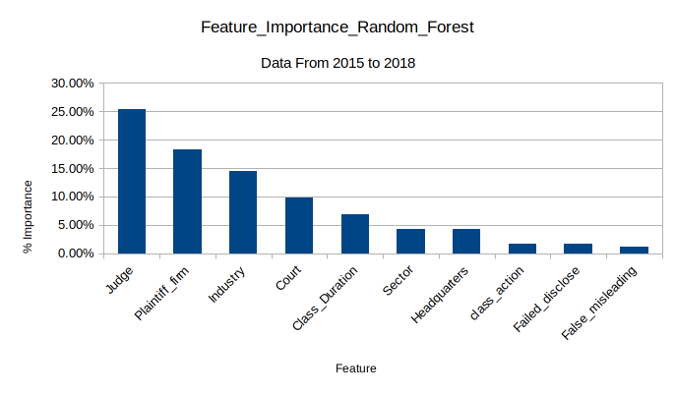
Feature Importance
Observations:
Interestingly, the Judge and Plaintiff firm appears to have the largest impact on the ability of the model to predict the correct outcome.
Further research:
See how the model reacts to grouping the class duration into smaller buckets.
Usage:
Caution should be taken when dealing with an new judge or Plaintiff firm with little historical experience in deciding Federal SCA cases

Slide 21
CONCLUSION: Key Takeaways & Further Inspection
Summary:
Goal to predict outcome SCA
Built scraper
Preliminary inspection showed positive results
Most models performed better than chance, with Logistic Regression and Random Forest performing best.
Further Inspection:
Feature Importance
Temporal Importance
Further build out dictionary of derived values
Chose a single model & optimize
Generate predictions for ongoing cases & measure model performance.

Slide 22
QUESTIONS?

Slide 23
APPENDIX: CONTENT
MYSQL TABLE
DATA INSPECTION FOR NULL VALUES
CASE DISMISSAL RATES BY YEAR
HEAT MAP: DERIVED FEATURE APPEARANCE FOR ALL CASES
HEAT MAP: DERIVED FEATURE APPEARANCE FOR SETTLEMENTS

Slide 24
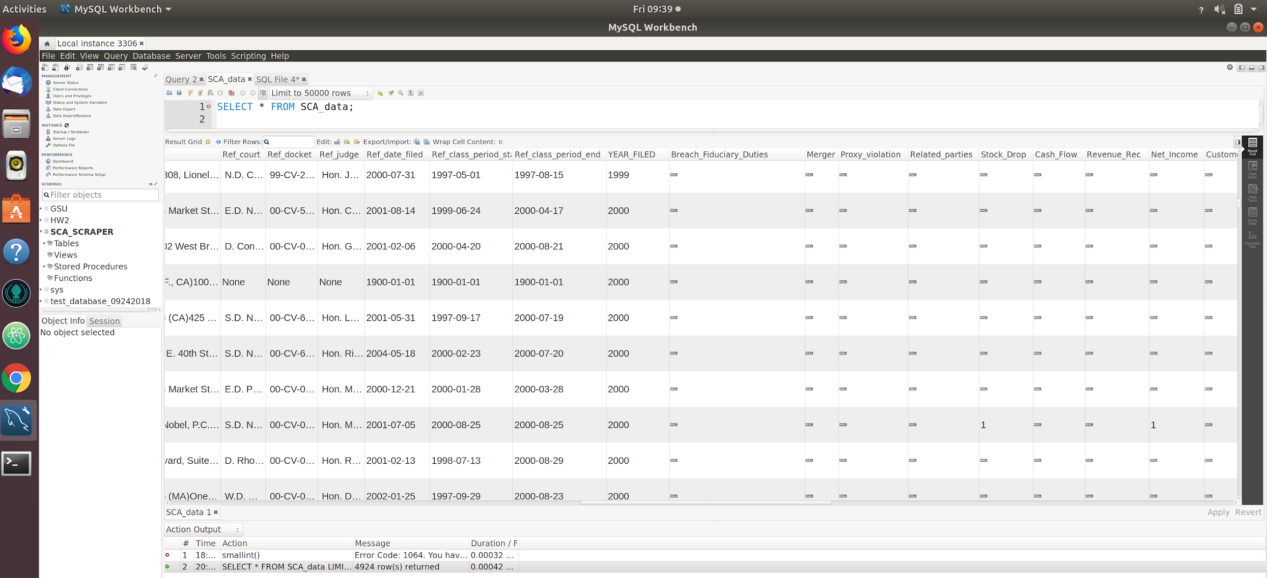
APPENDIX: MYSQL TABLE

Slide 25
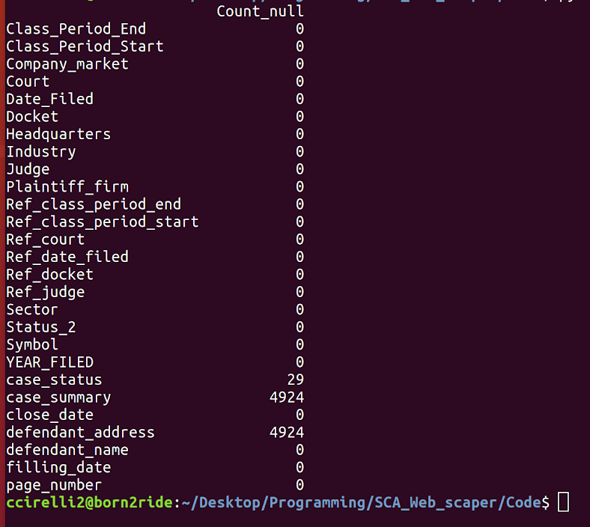
APPENDIX: Data Inspection Phase
Observations:
The scraper was effective at scraping 100% of the values for all but three categories - case_status, case_summary, defendant_address.
ML Data Preparation:
Drop case_summary and defendant_address columns.
Limit SQL query where case_status IS NOT NULL.

Slide 26
APPENDIX: Case Dismissal Rate By Year
Observations:
Dismissal Rates as a ratio to Dismissed + Settled progressively increases toward present time.
Therefore, we should not use a time-series analysis without accounting for this distribution in the data toward dismissals.

Slide 27
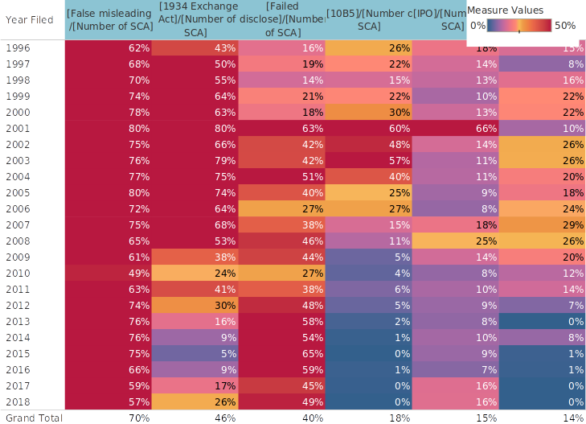
APPENDIX: DERIVED FEATURES & ALL CASES

Slide 28
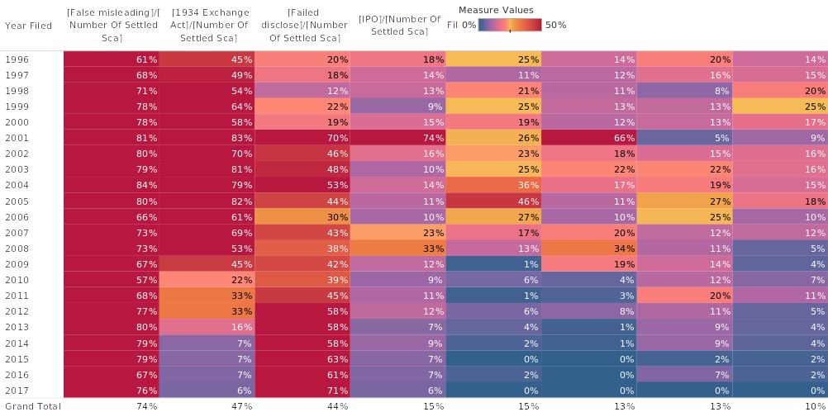
APPENDIX: DERIVED VALUES & SETTLEMENTS

Slide 29
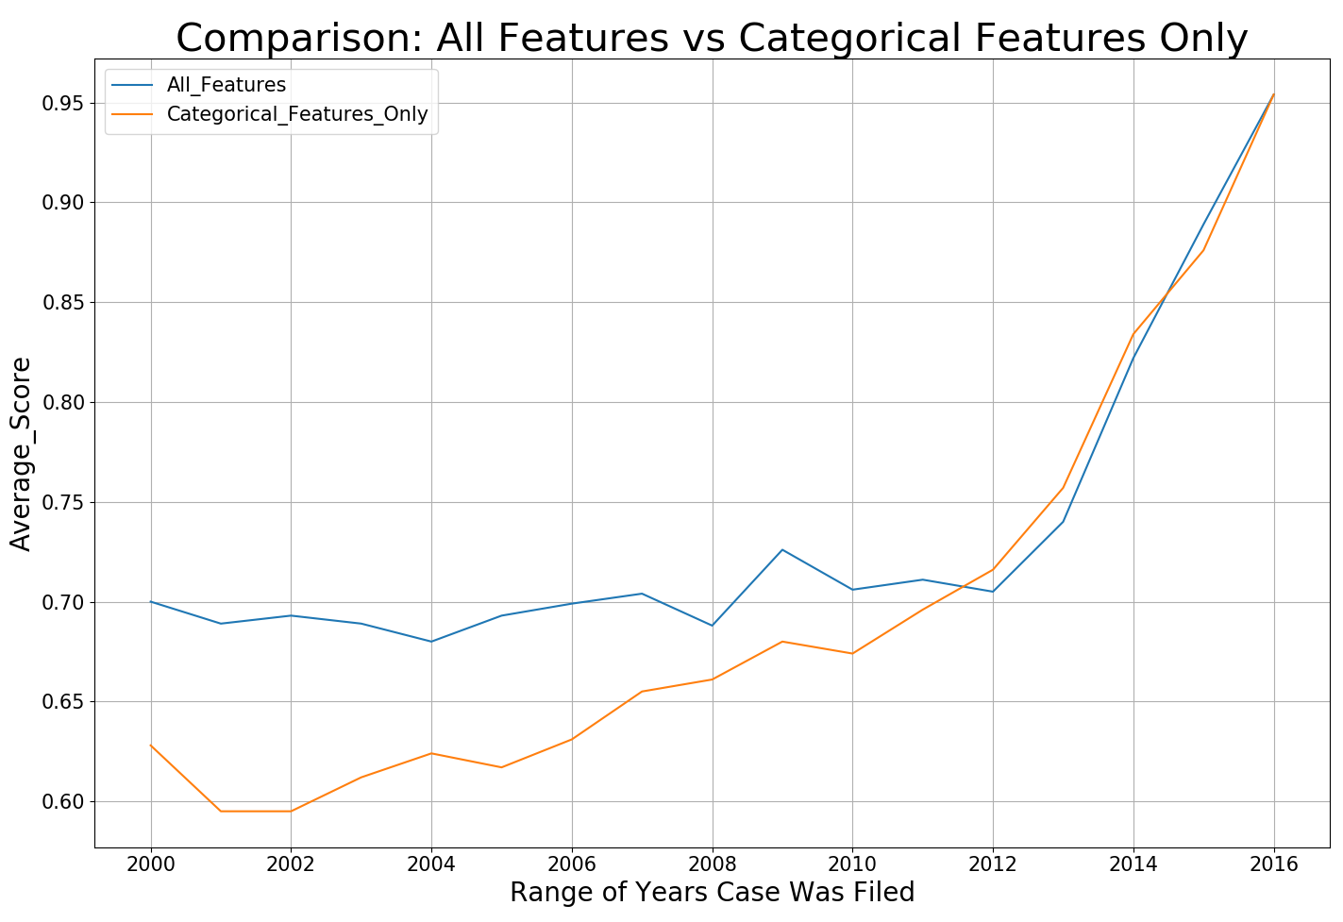
Appendix: Importance Derived vs Categorical Features

Slide 30
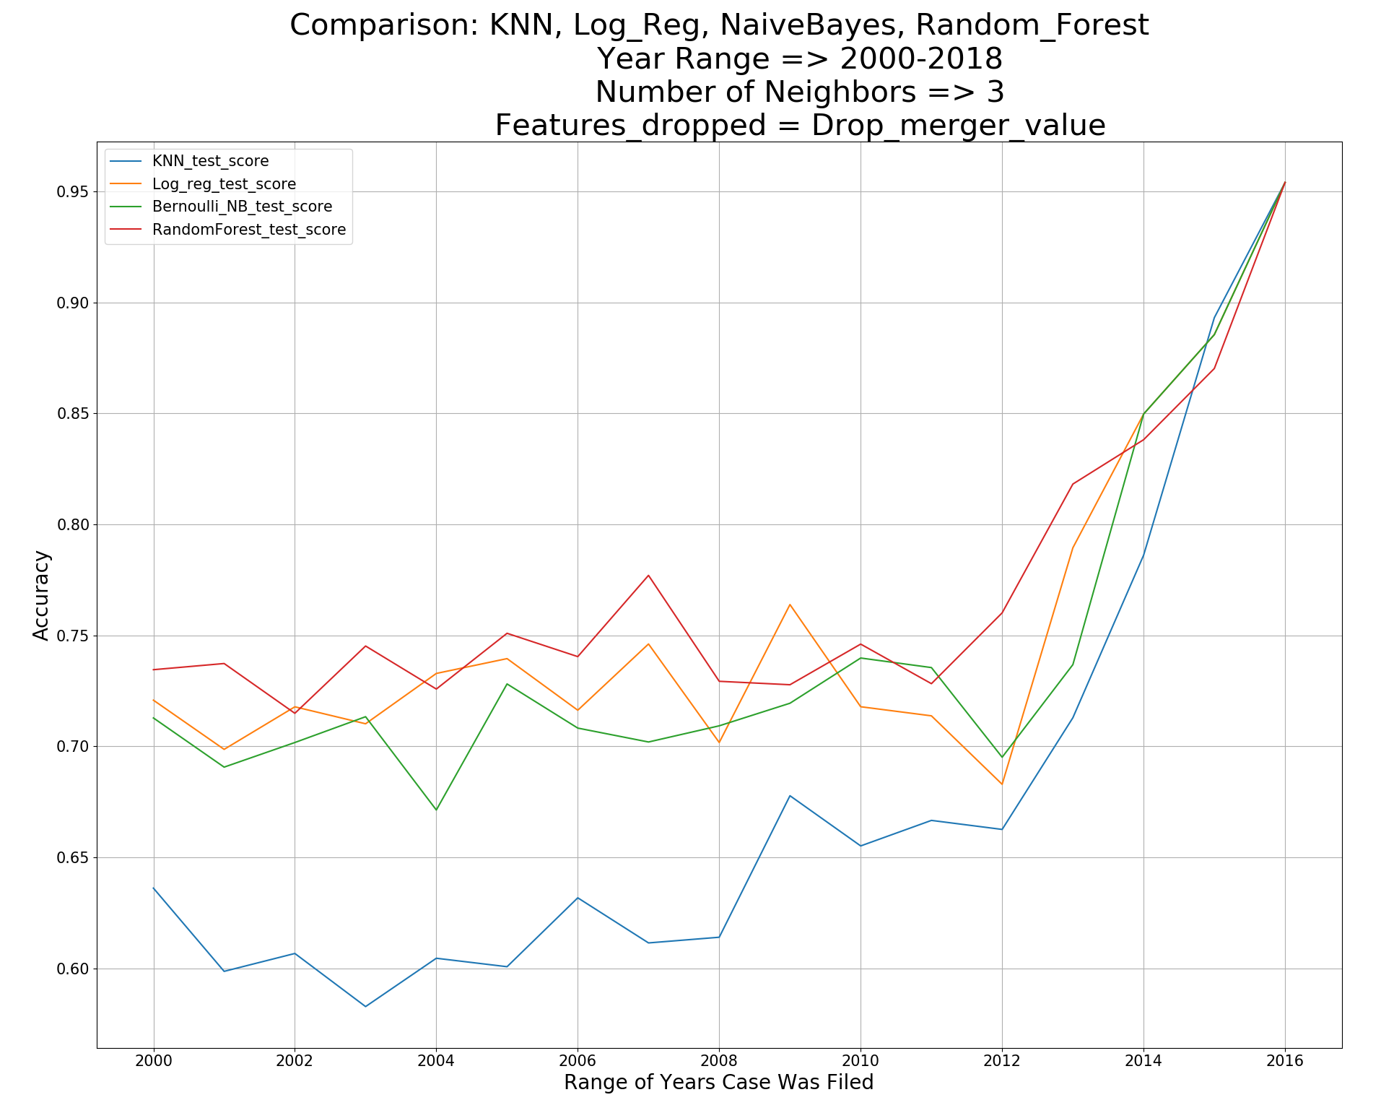
APPENDIX: MODEL PERFORMANCE BASED YEAR OF CASE FILED

